Slide 1


Fund Raising Study Group
UCSF Global Entrepreneurship Online Class 2020

Slide 2
Fund Raising lessons learned
- Connecting with Angels
- Pitch Perfect
- Term Sheets (Venture Capital)
- Successful Grant Application

Slide 3
Connecting with Angels
- Reach out to founders, online platforms: AngelList, Crunchbase etc.
- Ask someone to introduce you.
- Fundraising is a SALES role. Be prepared.
- Always follow up 10 days later if you don’t hear back.
- Life Sciences Angels, Keiretsu Forum
- Don’t be afraid of Investors.

Slide 4
Pitch Perfect
- Focus on business opportunity and numbers.
- Be human. Don’t forget to make human connection.
- For decks – make a 15-20 slide deck with a strong email blurb about your company.
- Review your deck multiple times, read it wearing an investor’s shoes.

Slide 5
Term Sheets (Venture Capital )
- A venture capital term sheet is the short, readable document that is negotiated prior to the actual contract, laying out the important terms of your deal.
- Money Raised – minimum offering amount
- Valuation of the company – main point of negotiation
- You actually don’t need a IP for term sheets

Slide 6
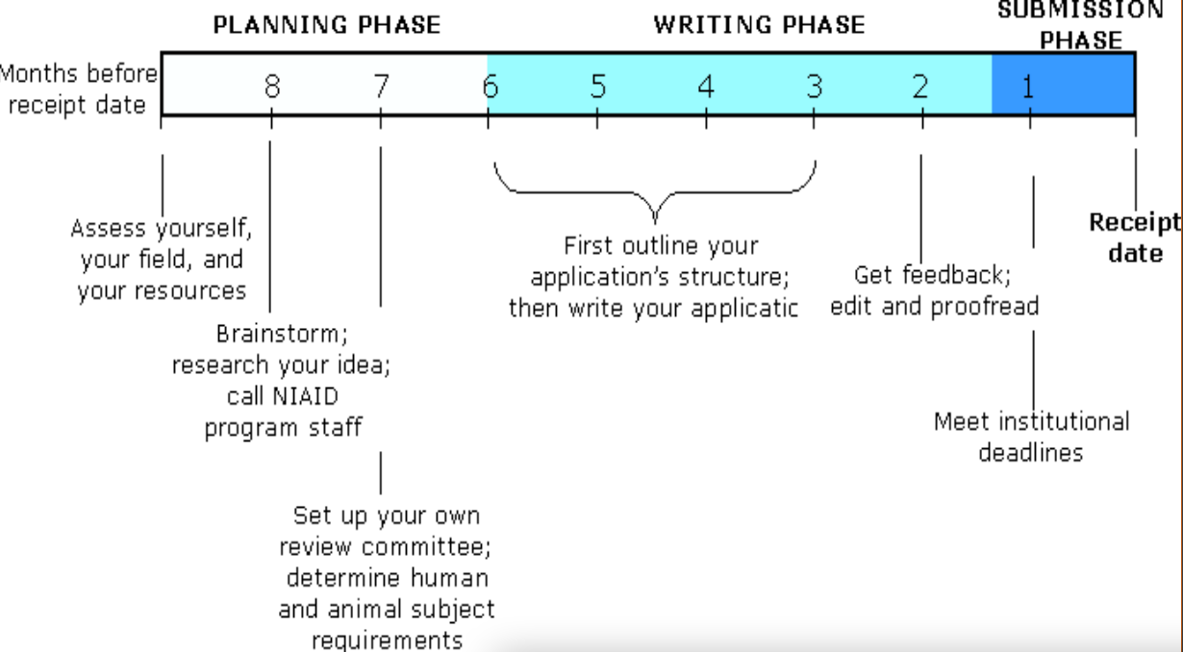
Successful Grant Applications
NIH -Review funding announcements and guide notices (sign up)
Discuss your “concept idea” with PDs & SOs (NIH)
What reviewer looks for? - Are the specific aims logical? Are the research procedures well designed? Are the investigators qualified? are facilities adequate?
Foundations – The Foundation Directory Online, Chronicle of Philanthropy, Inside Philanthropy and SSIR have useful information about foundations.
Even if you get a no, ask them politely who else you should be talking to

Slide 7

Upcoming Webinars on Fund-Raising

Slide 8

Thank you!

